Slide 1
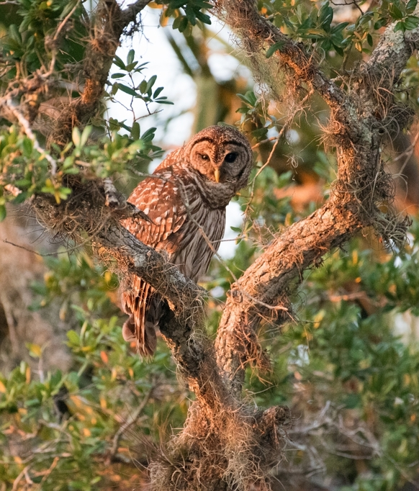


Citizen science as an approach for valuation of biodiversity in Environmental Impact Statements
Brittany Mason, Carly Winnebald, Blaze Smith, Laura López-Hoffman, and Corey T. Callaghan

Slide 2











Biodiversity and Ecosystem Services
Pollination
Climate regulation
Nutrient cycling
Water Purification
Clean drinking water
Food
Clean air
Aesthetic benefit

Slide 3
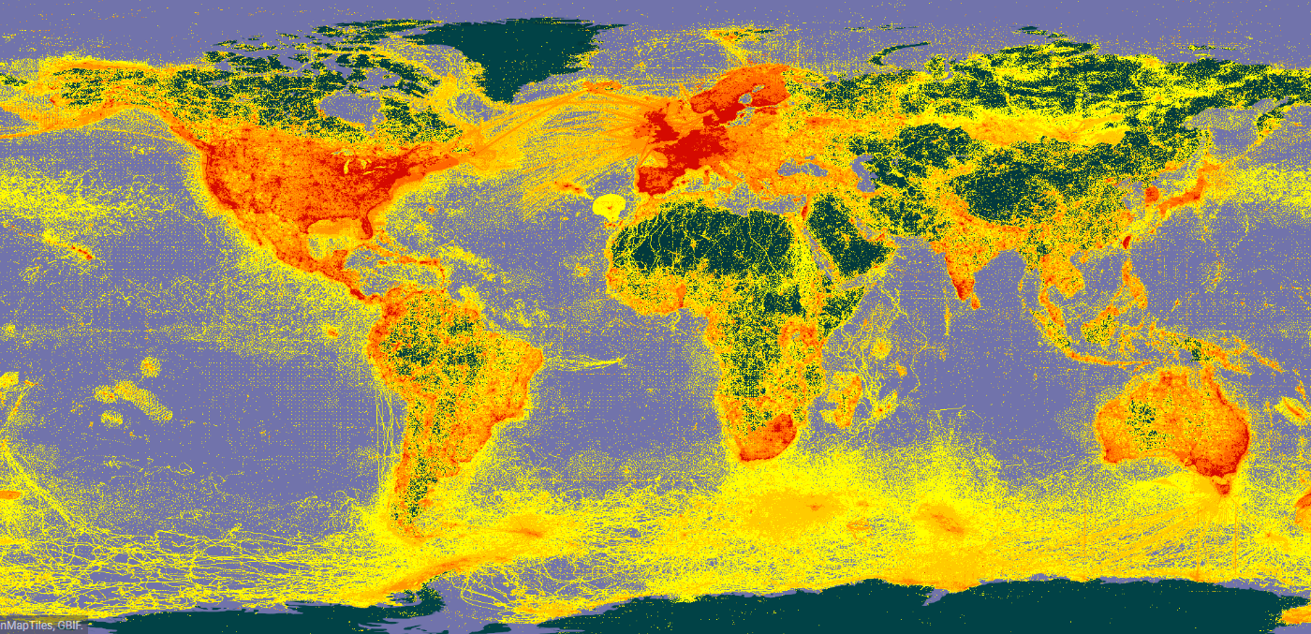



What is Citizen Science?
Also commonly referred to as participatory science or community science
Involves public engagement, education, and data collection
Citizen science programs are interdisciplinary and result in scientific advancement
Jordan et al. 2015. Citizen science as a distinct field of inquiry

Slide 4
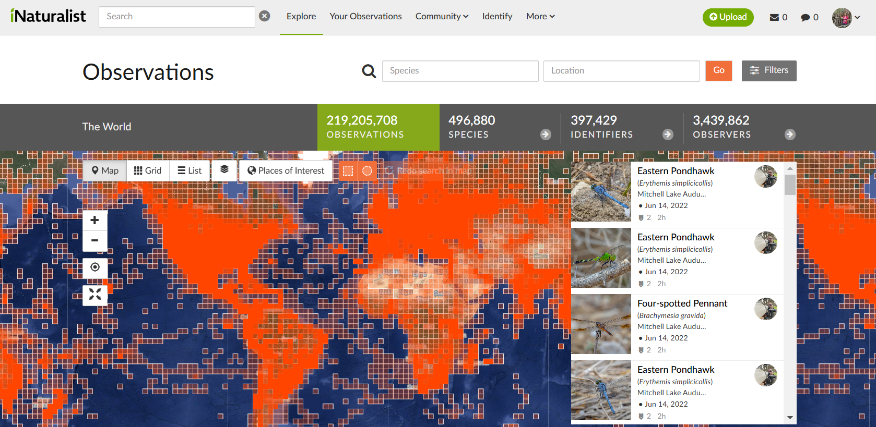

Slide 5
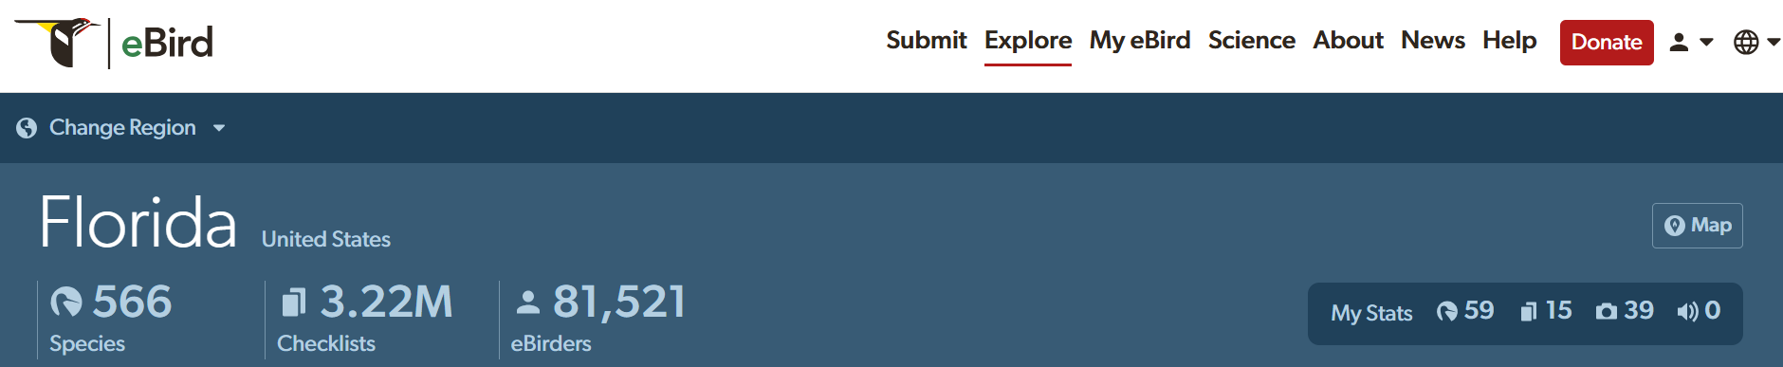
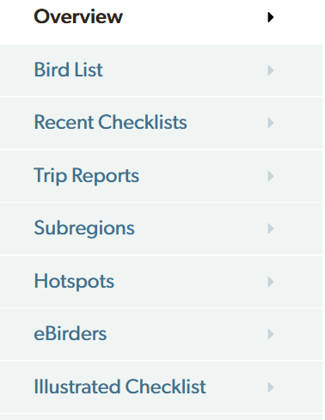
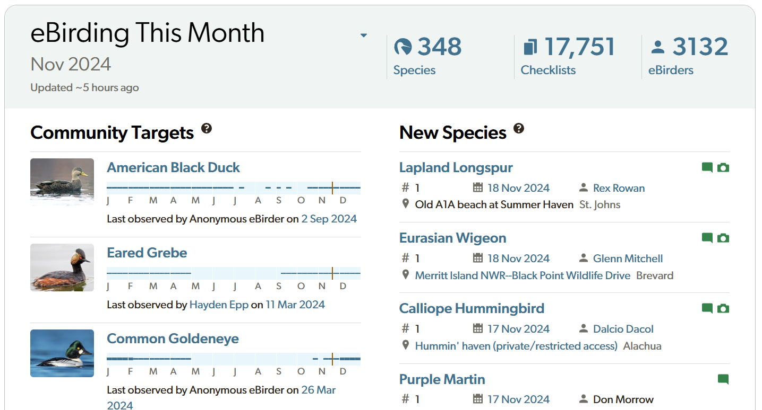

Slide 6
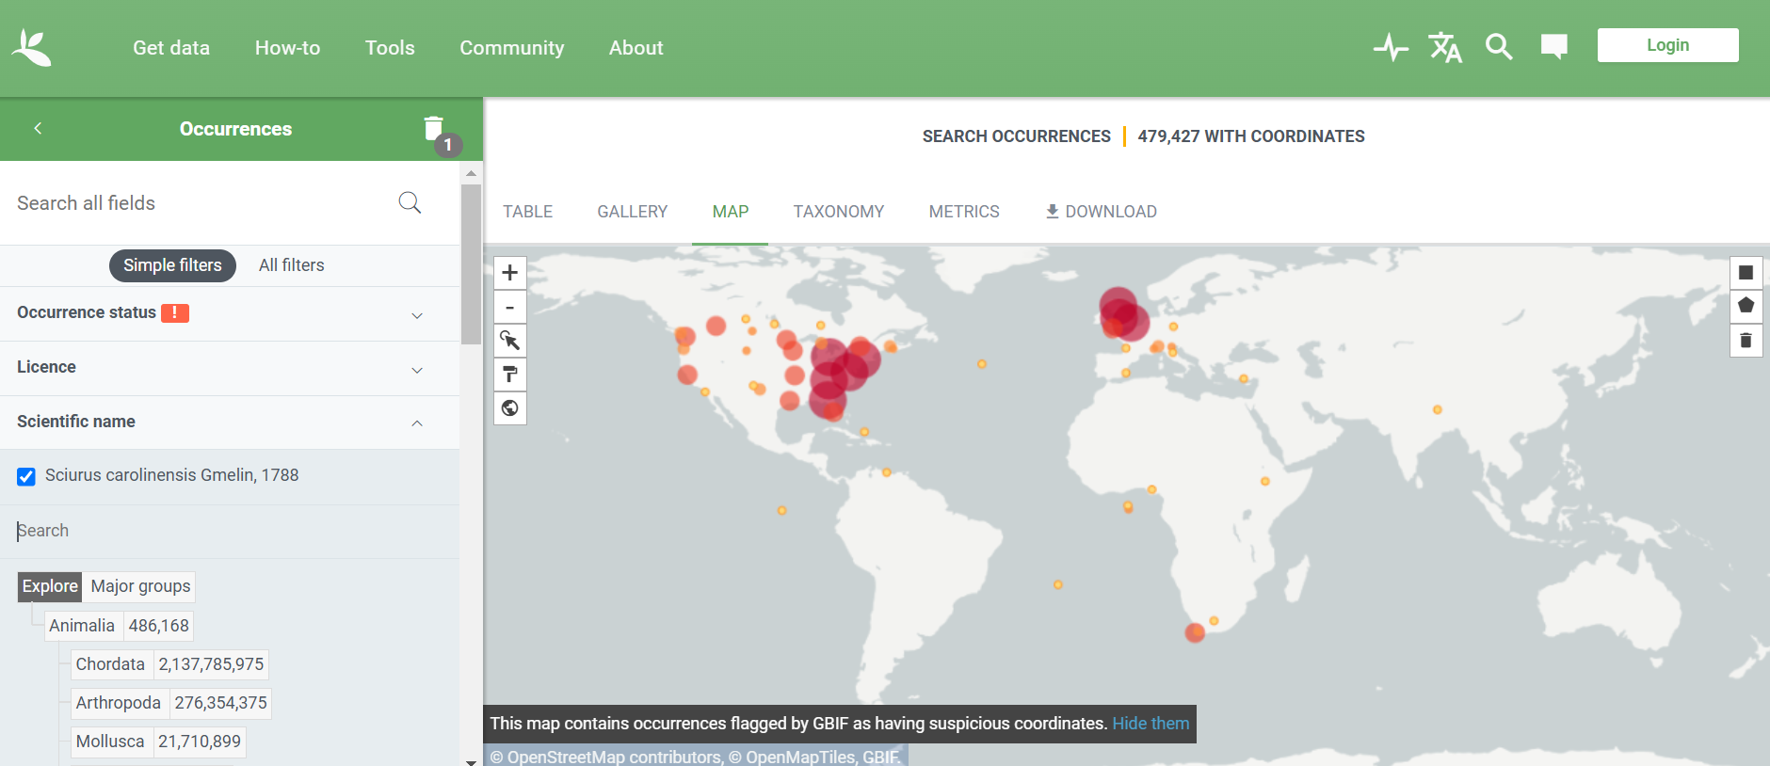
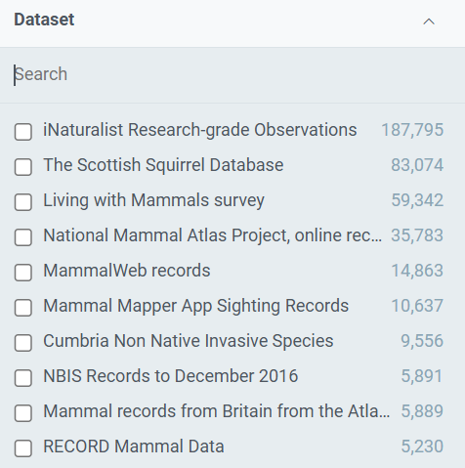
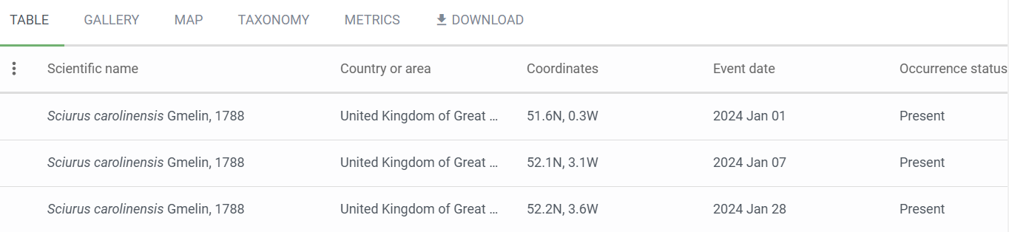

Slide 7

How is the data being used?

Slide 8










Citizen Science in Research
Literature Search
Screened articles for:
Tag articles
iNaturalist
Peer-review
2,137
Articles
Electronically available
Written in English or Spanish
Used iNaturalist data or review of iNaturalist

Slide 9
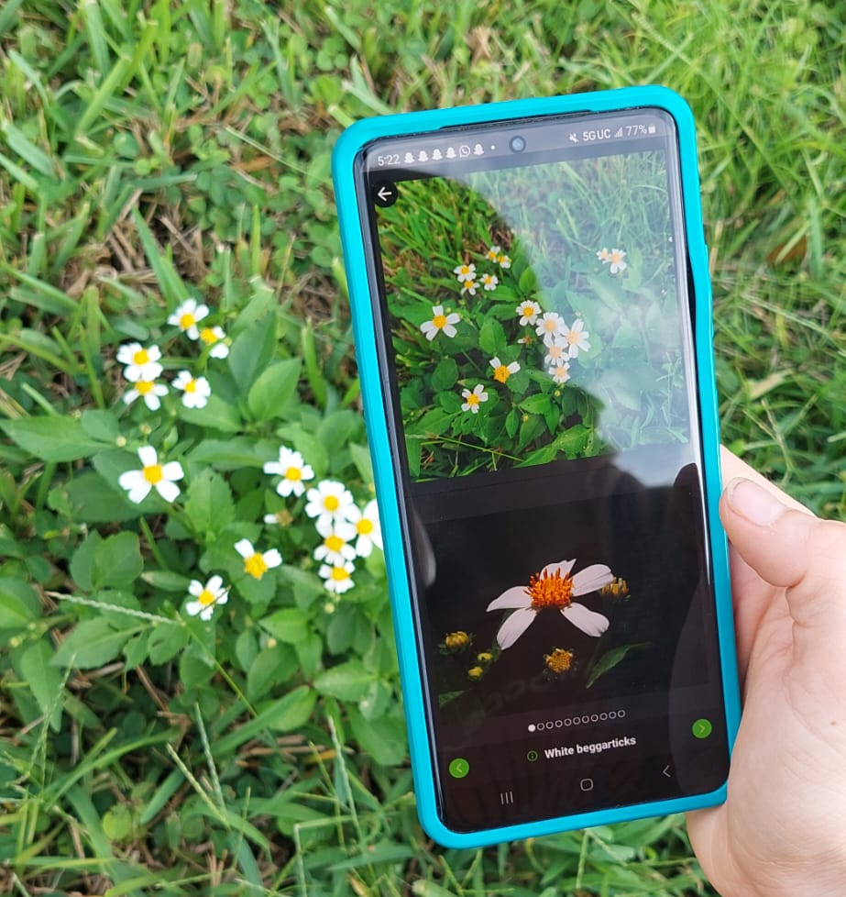
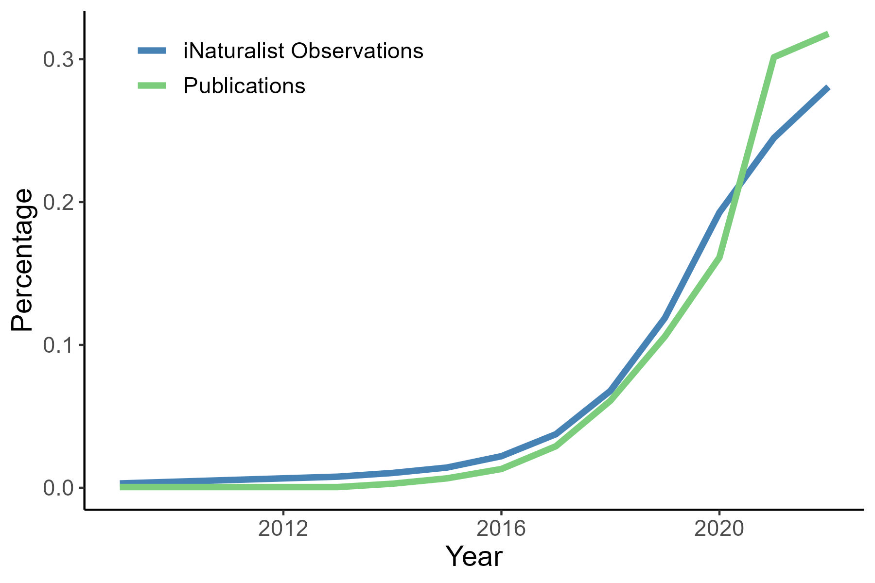
The use of iNaturalist data in scientific literature has grown significantly, paralleling the rapid increase in data availability from the platform.

Slide 10
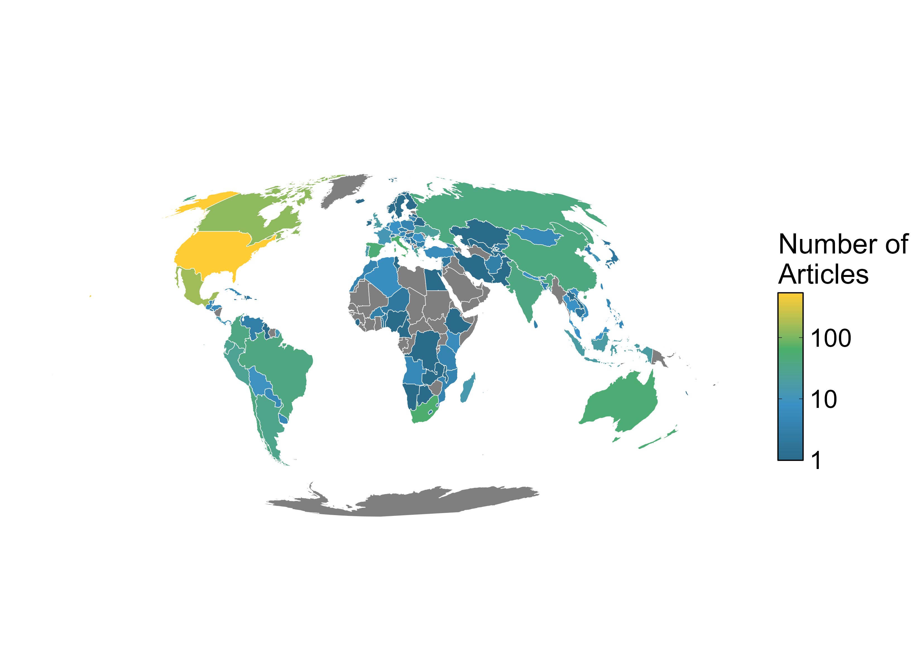
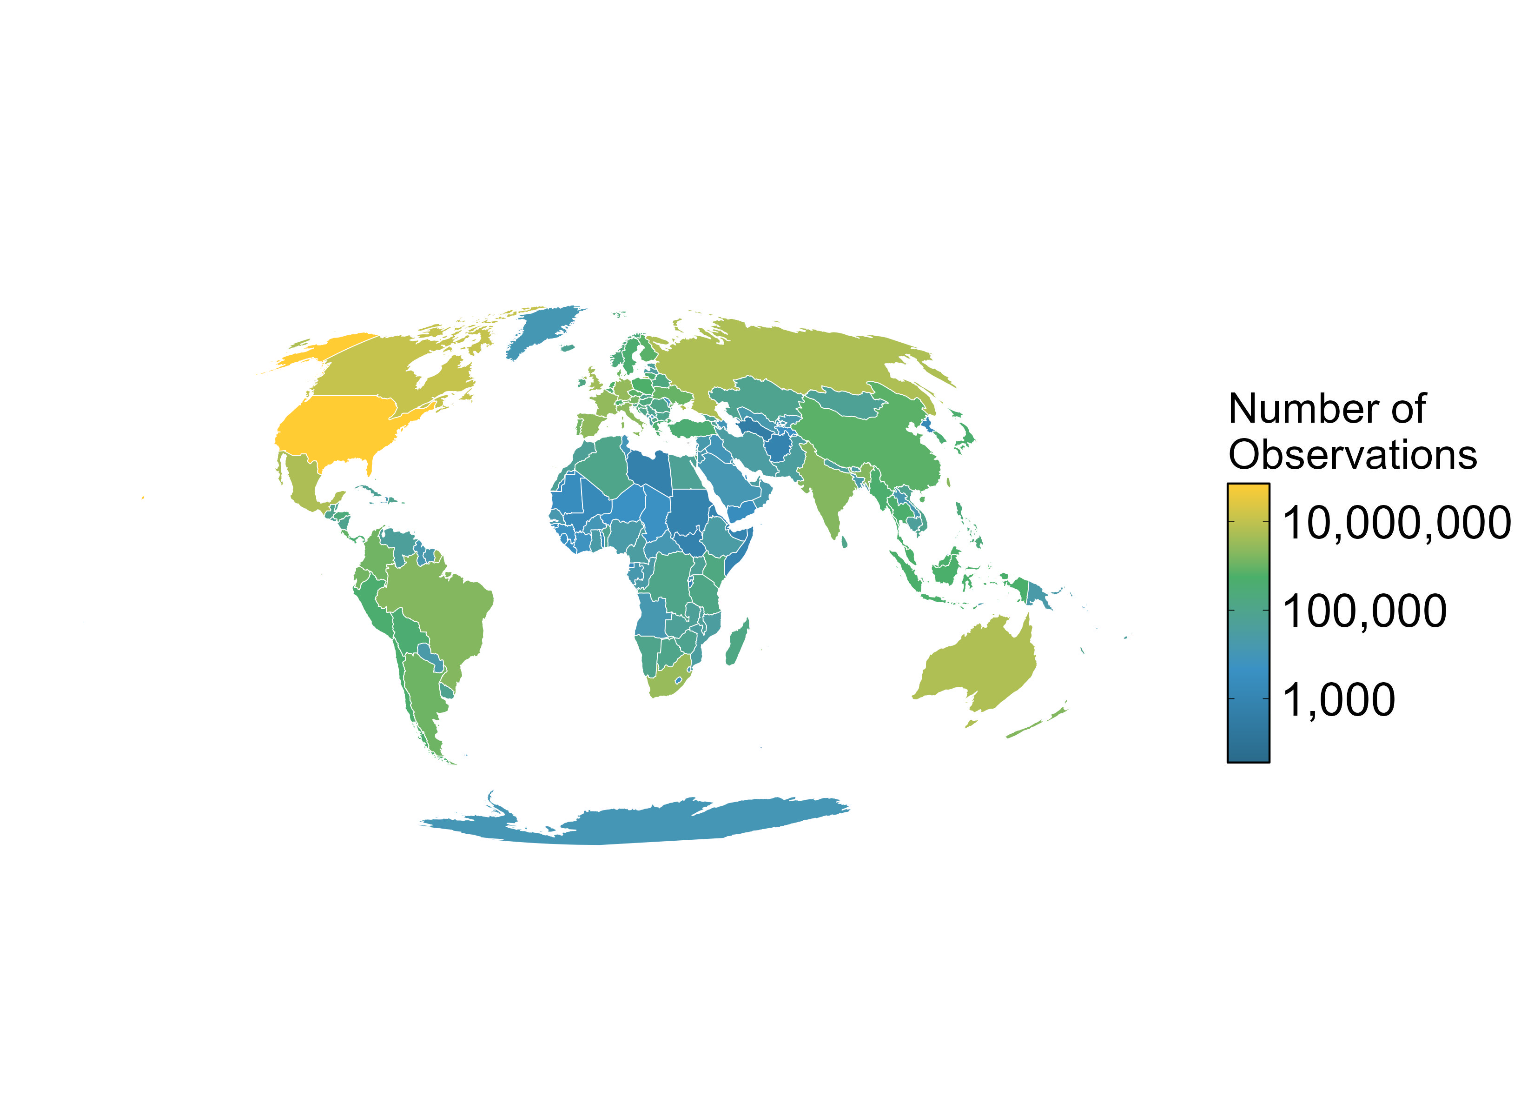
Global Distribution
iNaturalist literature
iNaturalist observations

Slide 11
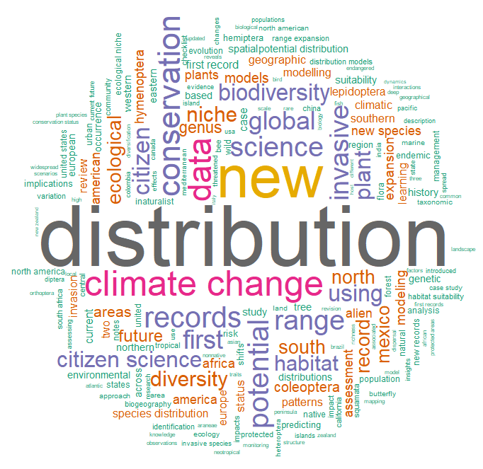
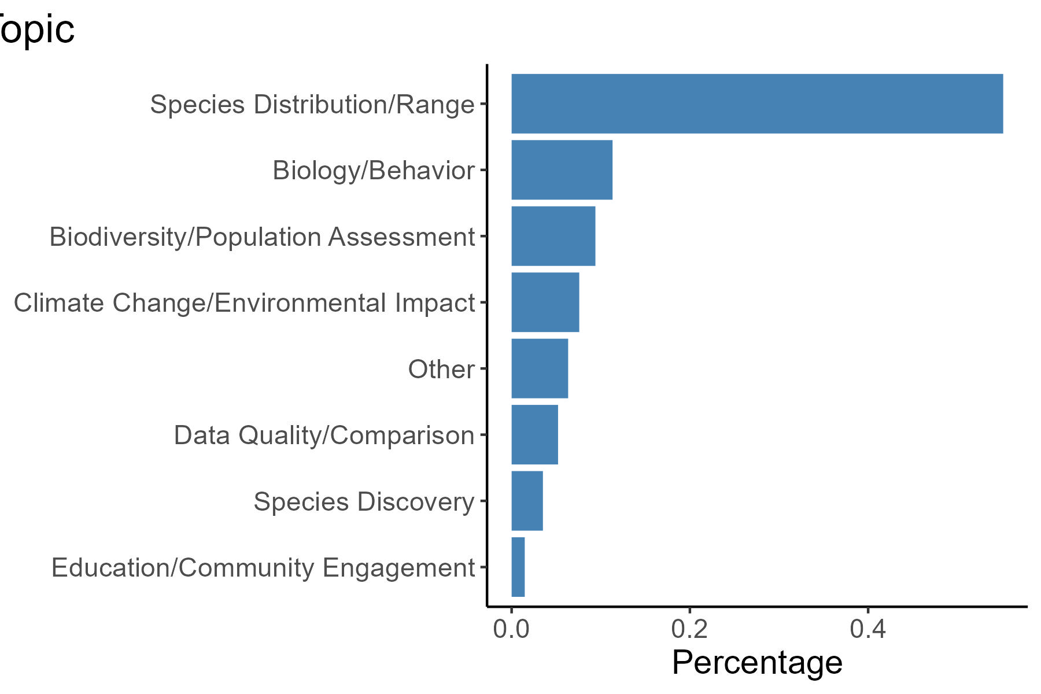
Range of topics
0 20 40

Slide 12
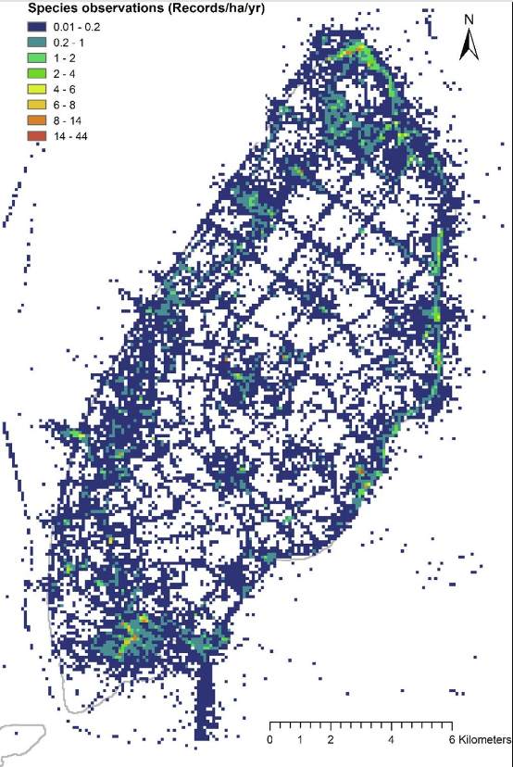
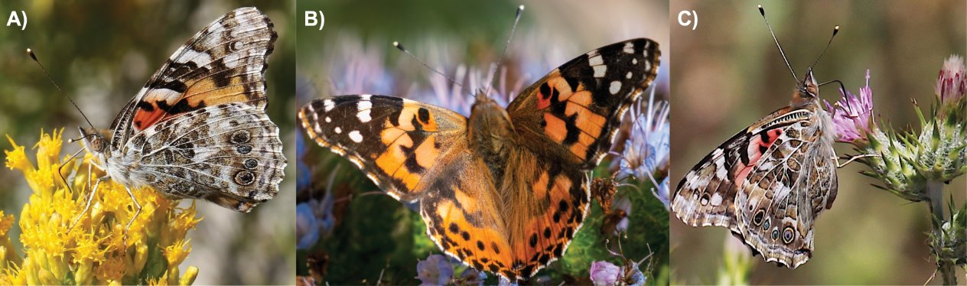

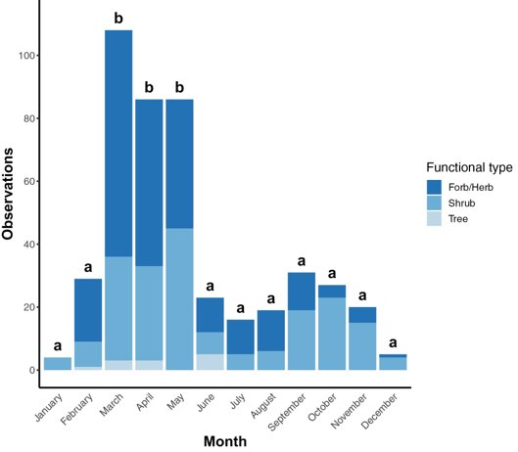
Citizen Science to Study Ecosystem Services
Map cultural ecosystem services
Determine plants visited by painted lady butterflies
Connect urban farmers to useful insect data
Saldivar, J. L. A., Romero, A. N., & Wilson Rankin, E. E. (2022). Community science reveals high diversity of nectaring plants visited by painted lady butterflies (Lepidoptera: Nymphalidae) in California sage scrub. Environmental Entomology, 51(6), 1141-1149.
Prudic, K. L., Wilson, J. K., Toshack, M. C., Gerst, K. L., Rosemartin, A., Crimmins, T. M., & Oliver, J. C. (2019). Creating the urban farmer’s almanac with citizen science data. Insects, 10(9), 294.
Havinga, I., Bogaart, P. W., Hein, L., & Tuia, D. (2020). Defining and spatially modelling cultural ecosystem services using crowdsourced data. Ecosystem Services, 43, 101091.

Slide 13
Citizen Science to Study Ecosystem Services
Map cultural ecosystem services
Determine plants visited by painted lady butterflies
Connect urban farmers to useful insect data
Saldivar, J. L. A., Romero, A. N., & Wilson Rankin, E. E. (2022). Community science reveals high diversity of nectaring plants visited by painted lady butterflies (Lepidoptera: Nymphalidae) in California sage scrub. Environmental Entomology, 51(6), 1141-1149.
Prudic, K. L., Wilson, J. K., Toshack, M. C., Gerst, K. L., Rosemartin, A., Crimmins, T. M., & Oliver, J. C. (2019). Creating the urban farmer’s almanac with citizen science data. Insects, 10(9), 294.
Havinga, I., Bogaart, P. W., Hein, L., & Tuia, D. (2020). Defining and spatially modelling cultural ecosystem services using crowdsourced data. Ecosystem Services, 43, 101091.

Slide 14
Citizen Science to Study Ecosystem Services
Map cultural ecosystem services
Determine plants visited by painted lady butterflies
Connect urban farmers to useful insect data
Saldivar, J. L. A., Romero, A. N., & Wilson Rankin, E. E. (2022). Community science reveals high diversity of nectaring plants visited by painted lady butterflies (Lepidoptera: Nymphalidae) in California sage scrub. Environmental Entomology, 51(6), 1141-1149.
Prudic, K. L., Wilson, J. K., Toshack, M. C., Gerst, K. L., Rosemartin, A., Crimmins, T. M., & Oliver, J. C. (2019). Creating the urban farmer’s almanac with citizen science data. Insects, 10(9), 294.
Havinga, I., Bogaart, P. W., Hein, L., & Tuia, D. (2020). Defining and spatially modelling cultural ecosystem services using crowdsourced data. Ecosystem Services, 43, 101091.

Slide 15
Citizen Science to Study Ecosystem Services
Map cultural ecosystem services
Determine plants visited by painted lady butterflies
Connect urban farmers to useful insect data
Saldivar, J. L. A., Romero, A. N., & Wilson Rankin, E. E. (2022). Community science reveals high diversity of nectaring plants visited by painted lady butterflies (Lepidoptera: Nymphalidae) in California sage scrub. Environmental Entomology, 51(6), 1141-1149.
Prudic, K. L., Wilson, J. K., Toshack, M. C., Gerst, K. L., Rosemartin, A., Crimmins, T. M., & Oliver, J. C. (2019). Creating the urban farmer’s almanac with citizen science data. Insects, 10(9), 294.
Havinga, I., Bogaart, P. W., Hein, L., & Tuia, D. (2020). Defining and spatially modelling cultural ecosystem services using crowdsourced data. Ecosystem Services, 43, 101091.

Slide 16

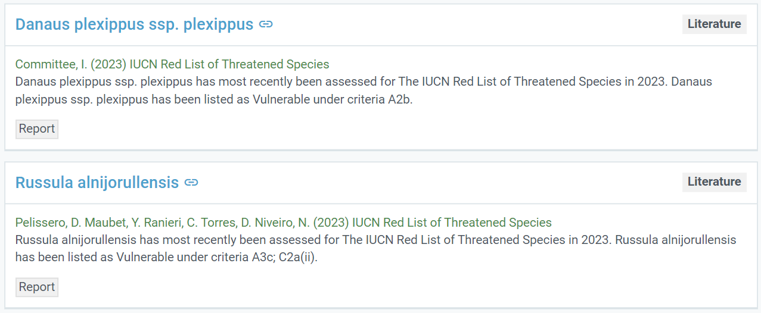
Citizen Science in Policy
>20,000

Slide 17
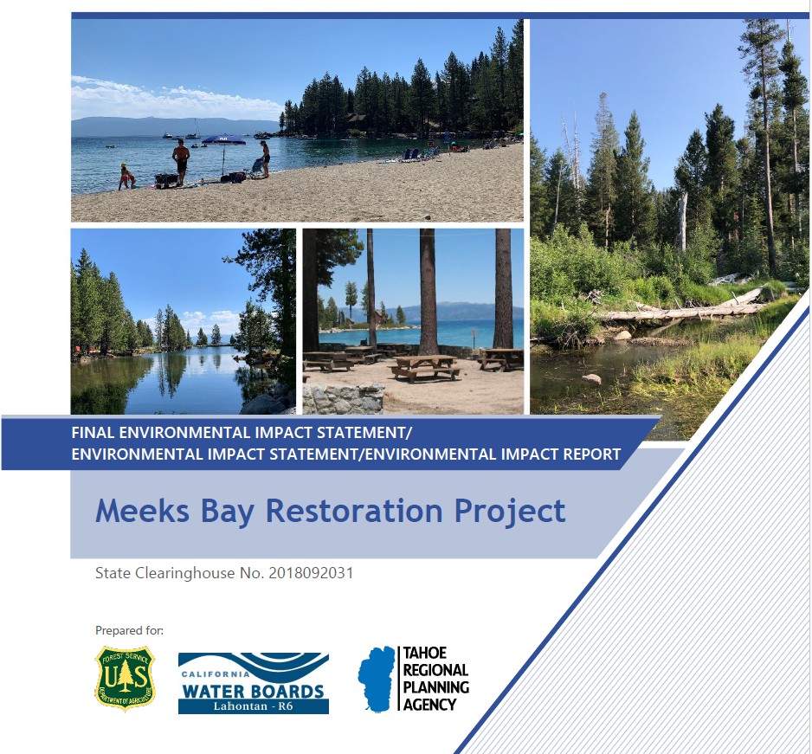
Research Question
What is the frequency and type of citizen science use in policy documents?
Citizen Science

Slide 18
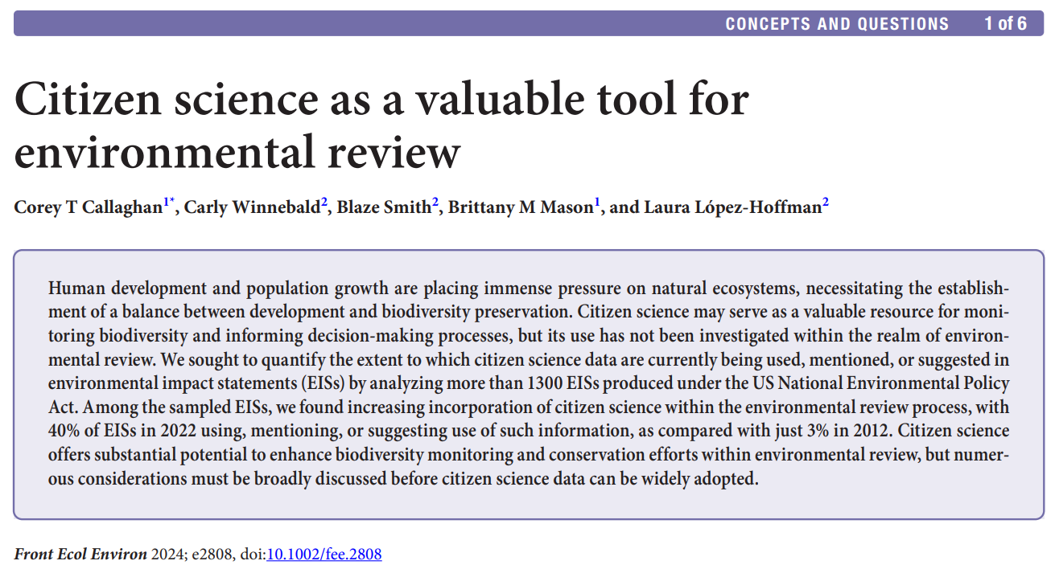

Slide 19
United States National Environmental Policy Act (NEPA)
Involves science and the public in federal decision-making
Requires environmental review of potential impacts of proposed federal action
There are three levels of analysis under NEPA – Environmental Impact Statements (EIS), Environmental Assessment, and Categorical Exclusion

Slide 20
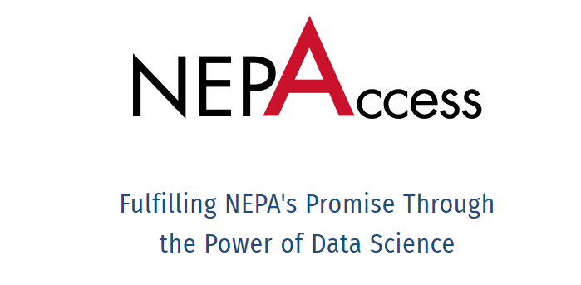
Environmental Impact Statement Search
We searched the NEPAccess database for EISs completed between 2012-2022 that contain the following keywords:
Citizen science
Community science
eBird
iNaturalist
We searched 1,355 EIS documents of which 228 were used in analysis

Slide 21
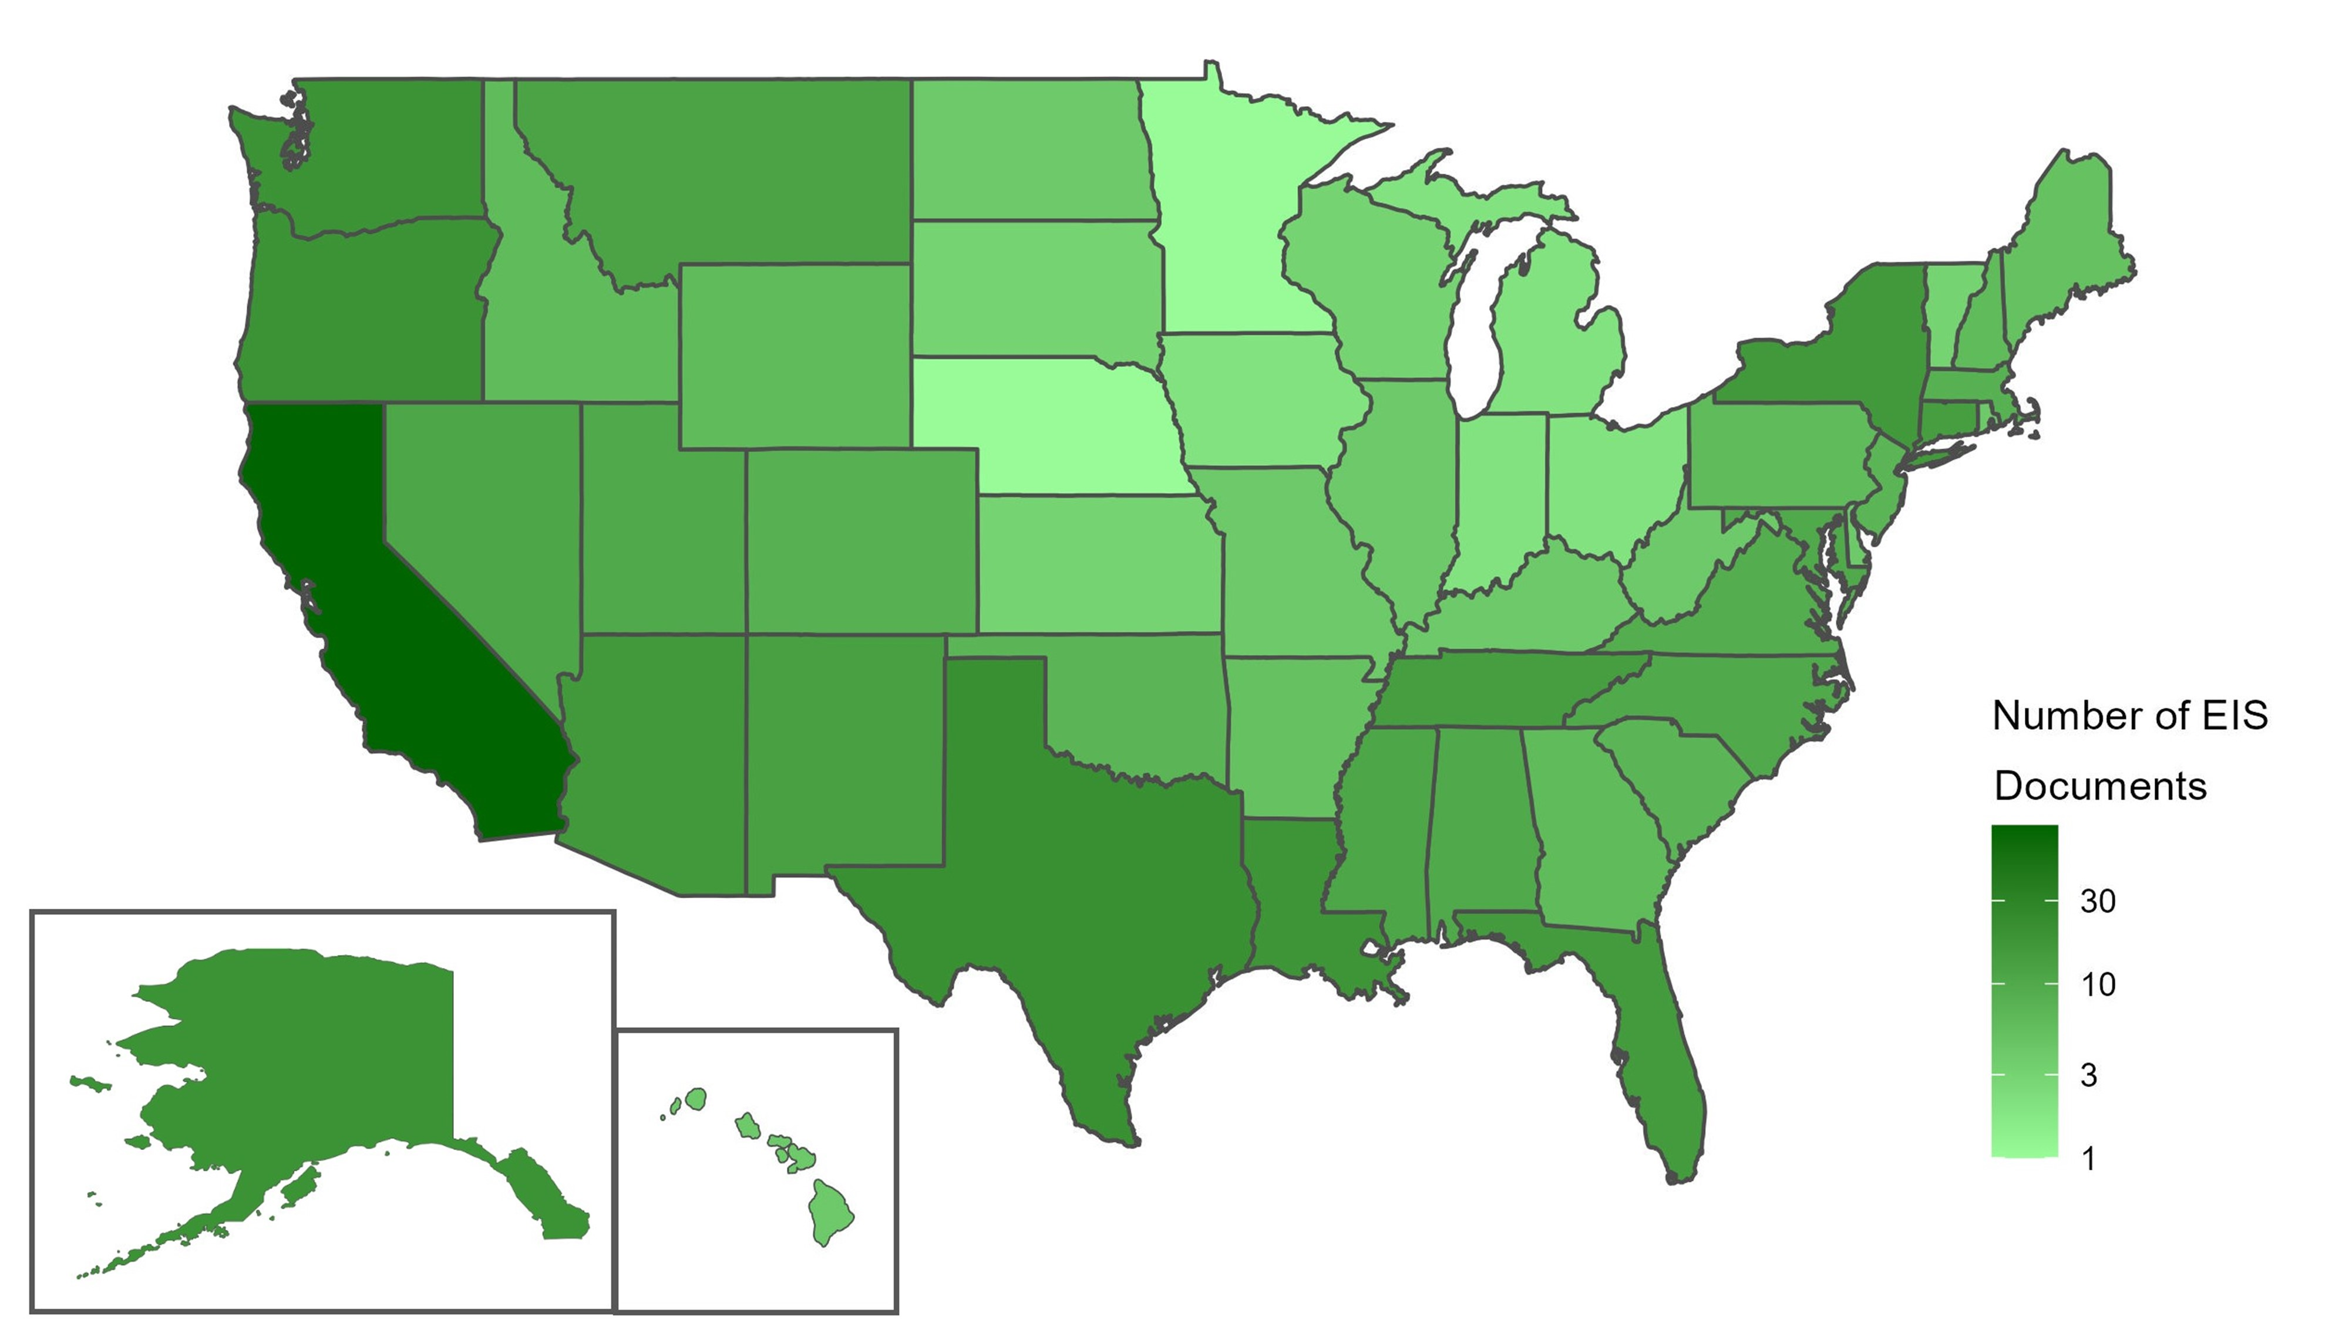

Slide 22
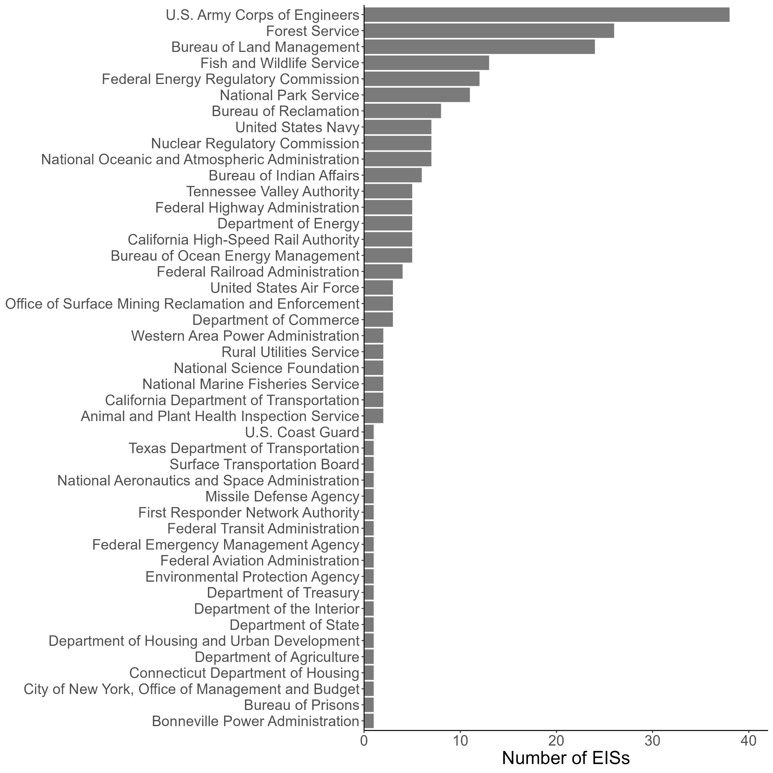
EISs using citizen science data were present across 45 agencies

Slide 23
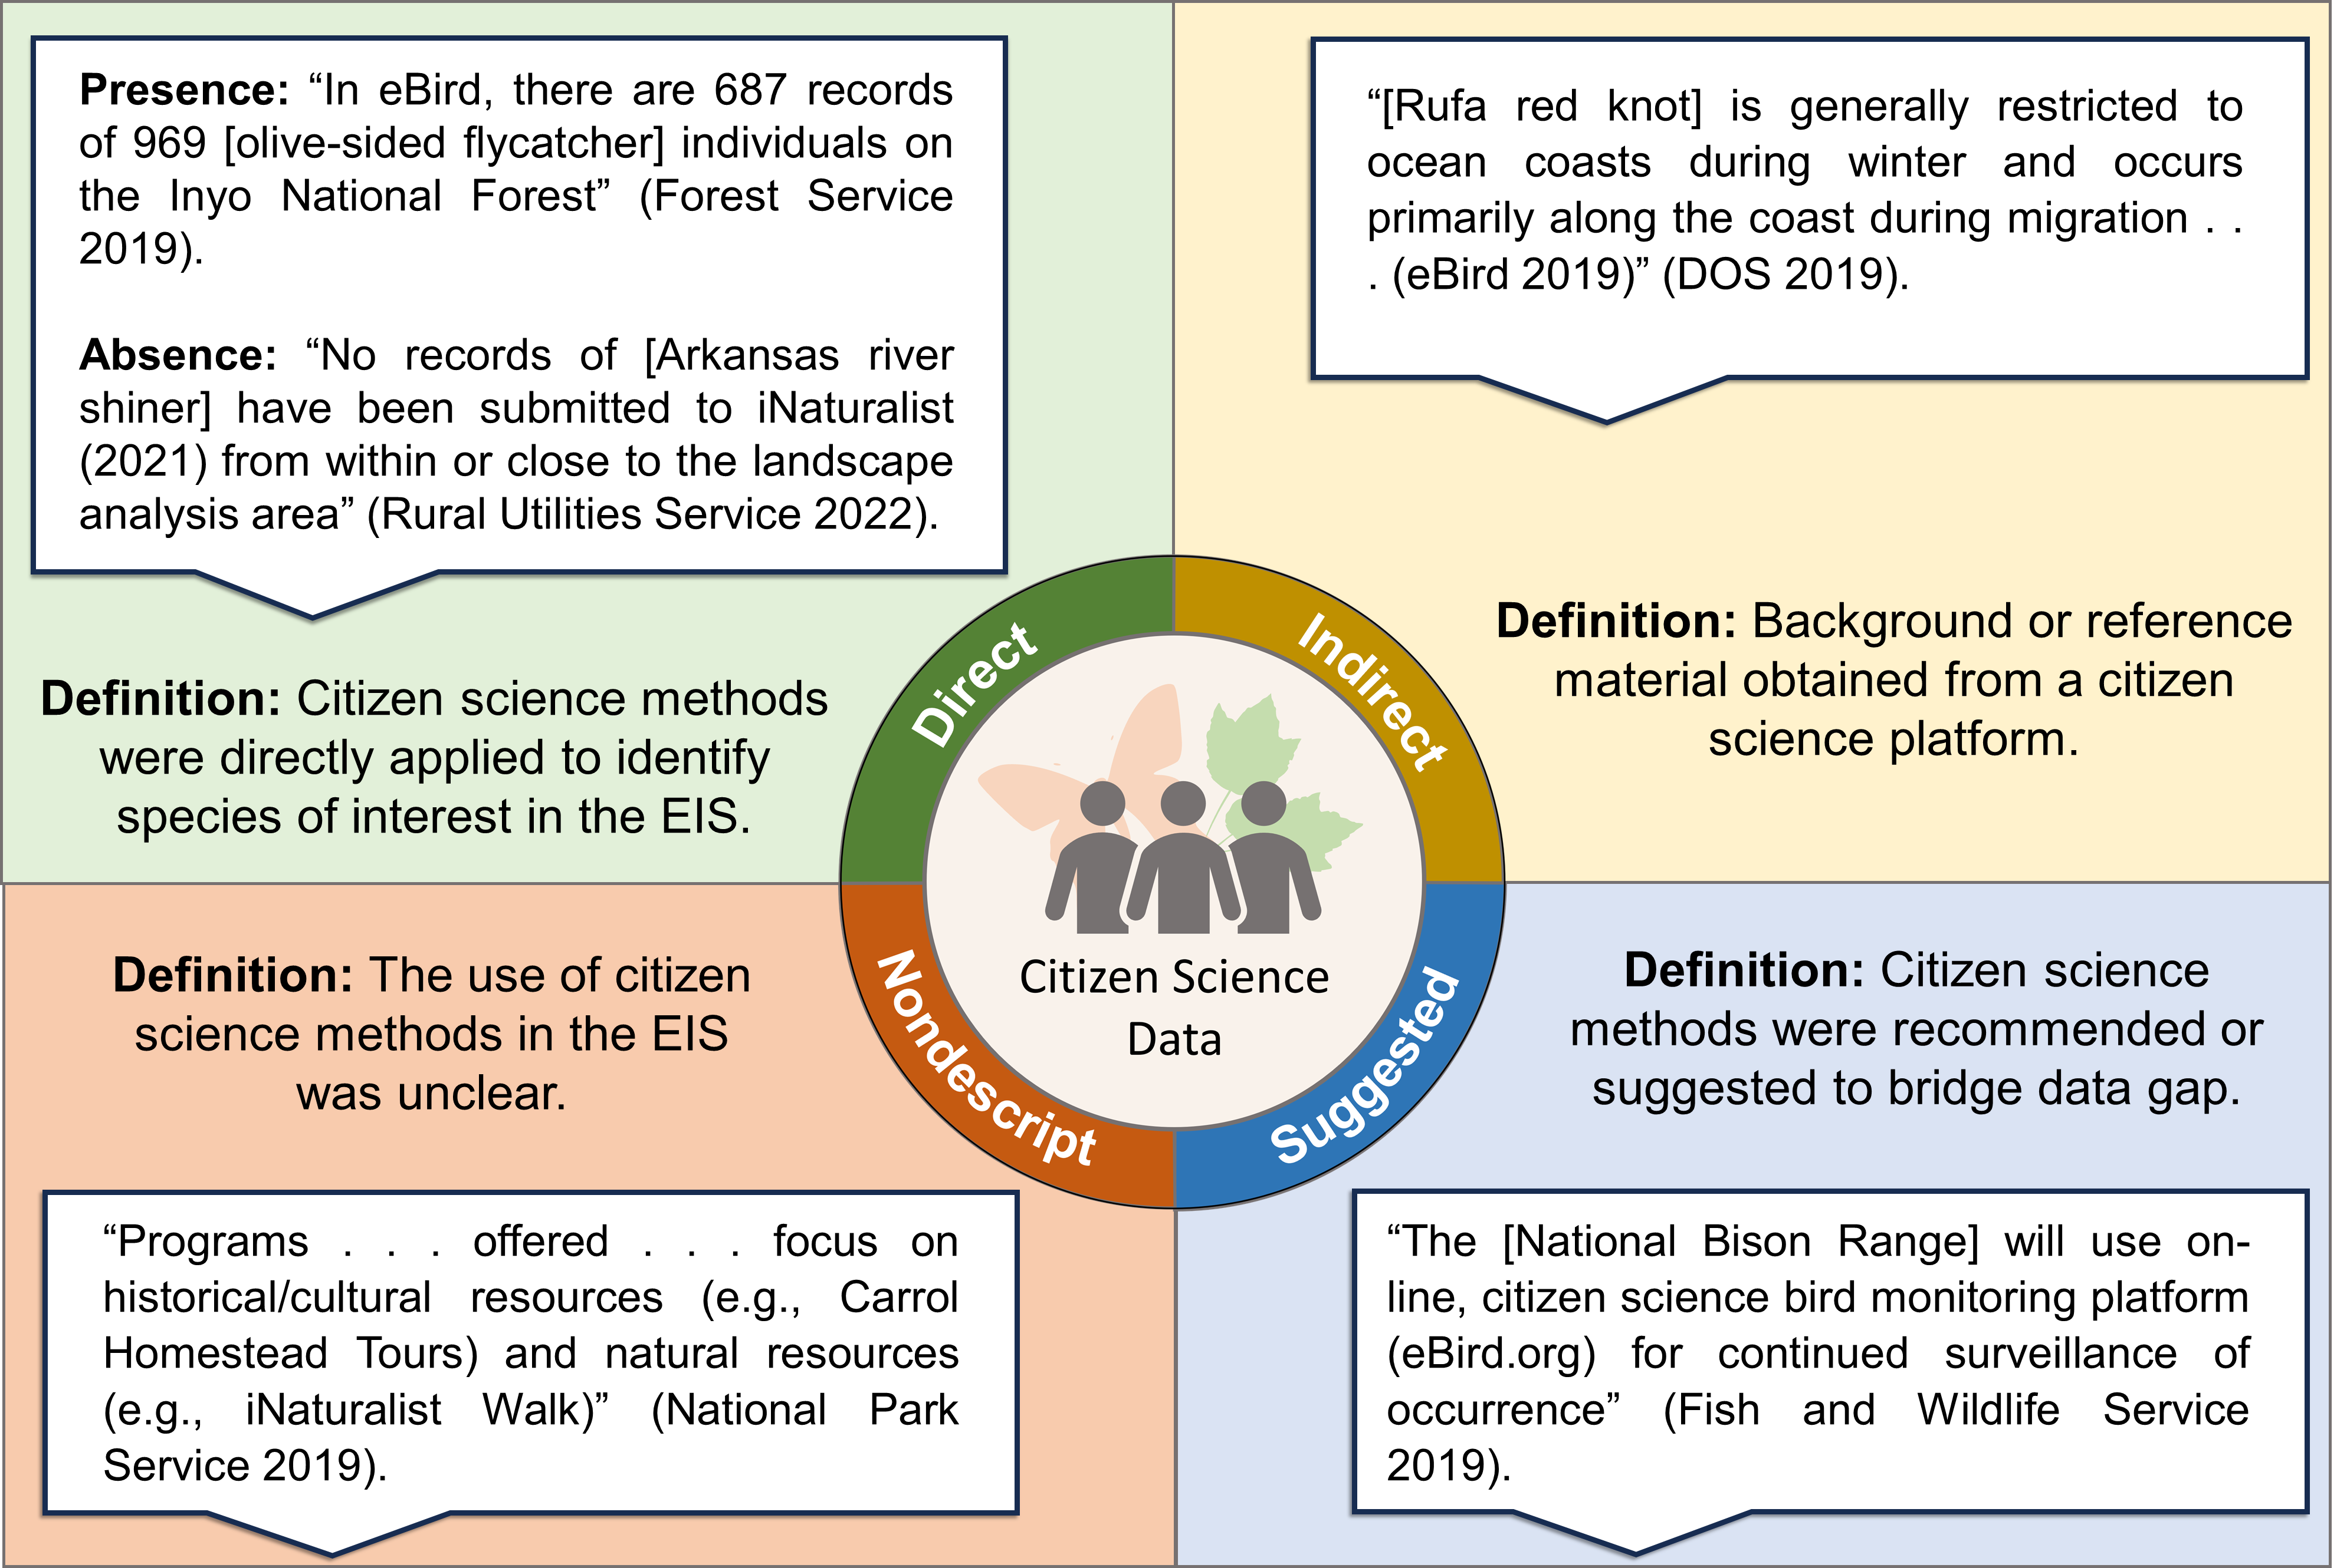

Slide 28
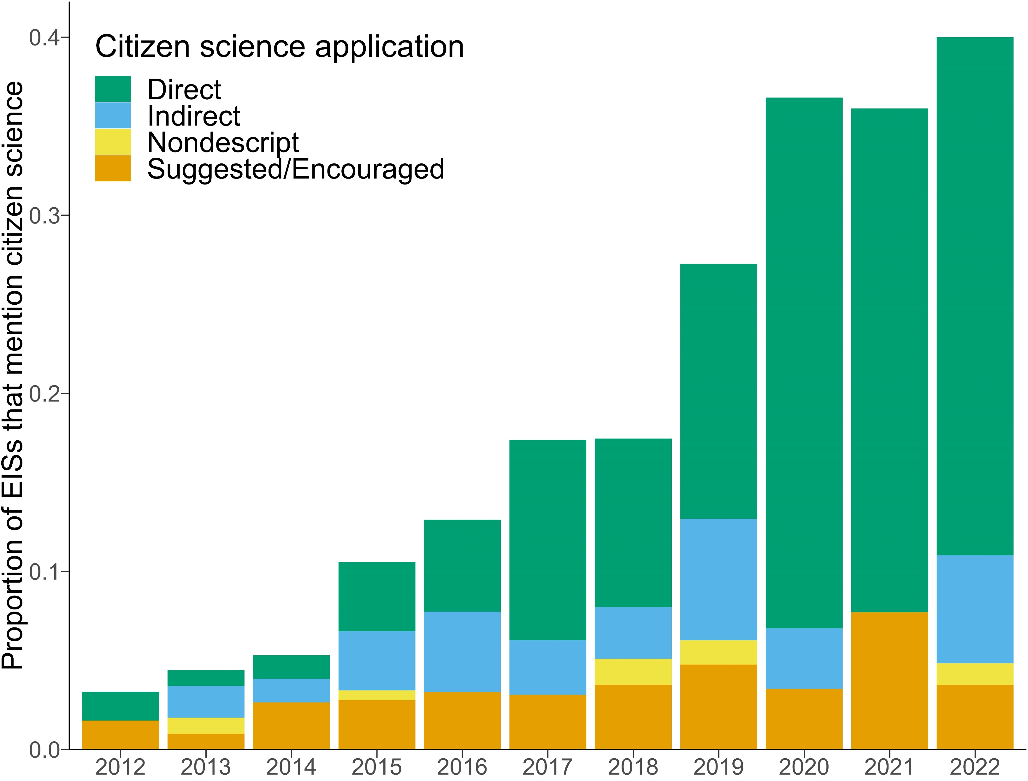

Slide 29
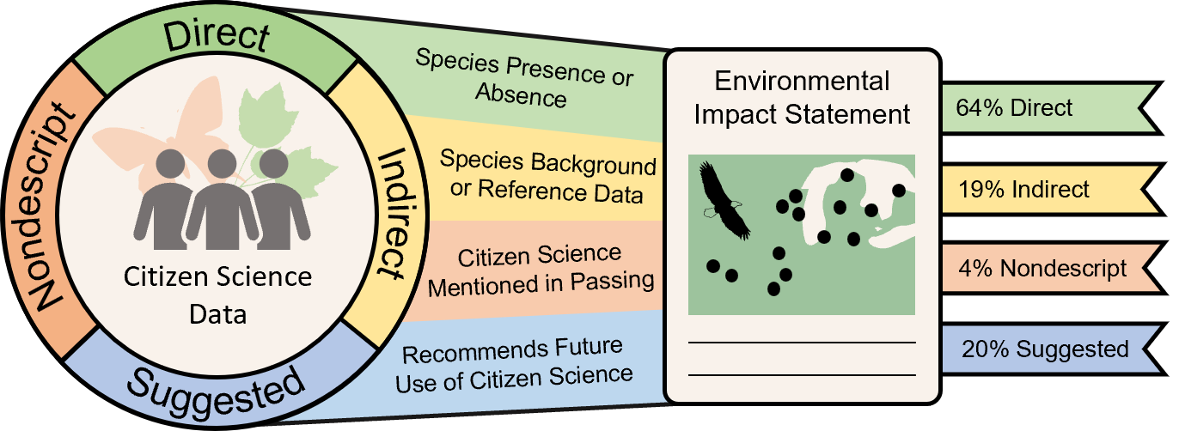

Numbers
87%
6%

Slide 30
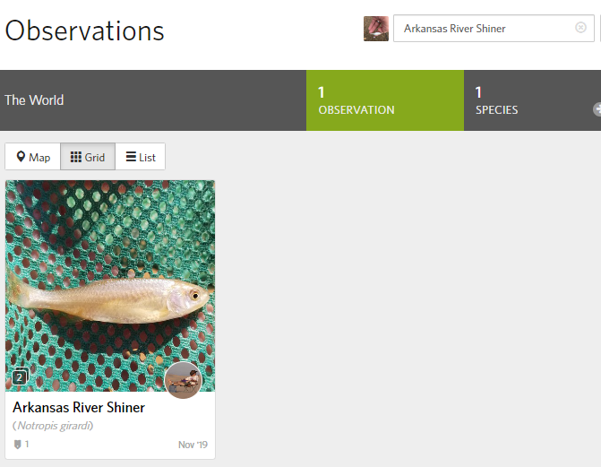
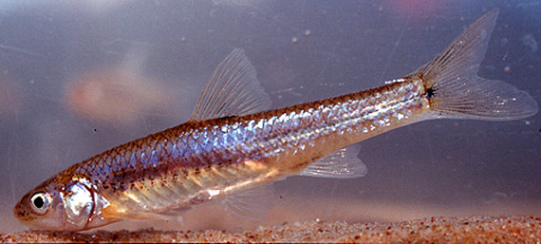
12% of all EISs used no sighting of a species as evidence of absence of that species
Photo by: Ken Collins
Worthy of future discussion
Not clear how they accounted for sampling effort or the iNaturalist location buffer for threatened species
“No records of [Arkansas river shiner] have been submitted to iNaturalist (2021) from within or close to the landscape analysis area” (Rural Utilities Service 2022)

Slide 31

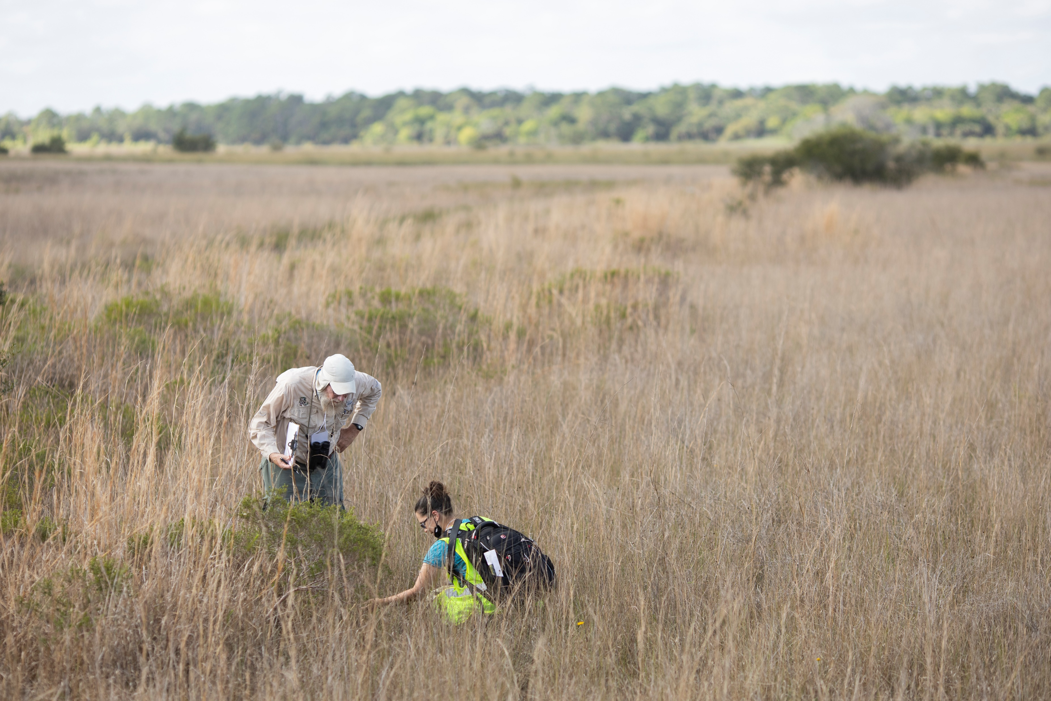


Future of Citizen Science in Environmental Review
Value of Citizen Science in Environmental Review
Agencies
Volunteers
Our results show increasing use and future potential of citizen science in environmental review
Agencies interacting with volunteers
More Data
Increased public engagement

Slide 32




Future of Citizen Science in Environmental Review
The future of citizen science use in environmental consulting is worthy of further discussion
Nuanced understanding of the data
Appropriate statistical analyses
Consider the extent that citizen science participants are willing to share data
Ensure conclusions are scientifically sound

Slide 33



Take home messages
Citizen science democratizes the data gathering process, potentially leading to more informed and inclusive environmental governance.
Broader adaptation requires considerations around data validity, participant engagement, and policy alignment.
Our work highlights the transformative potential of citizen science in bridging the gap between community involvement and ecosystem service conservation.

Slide 34
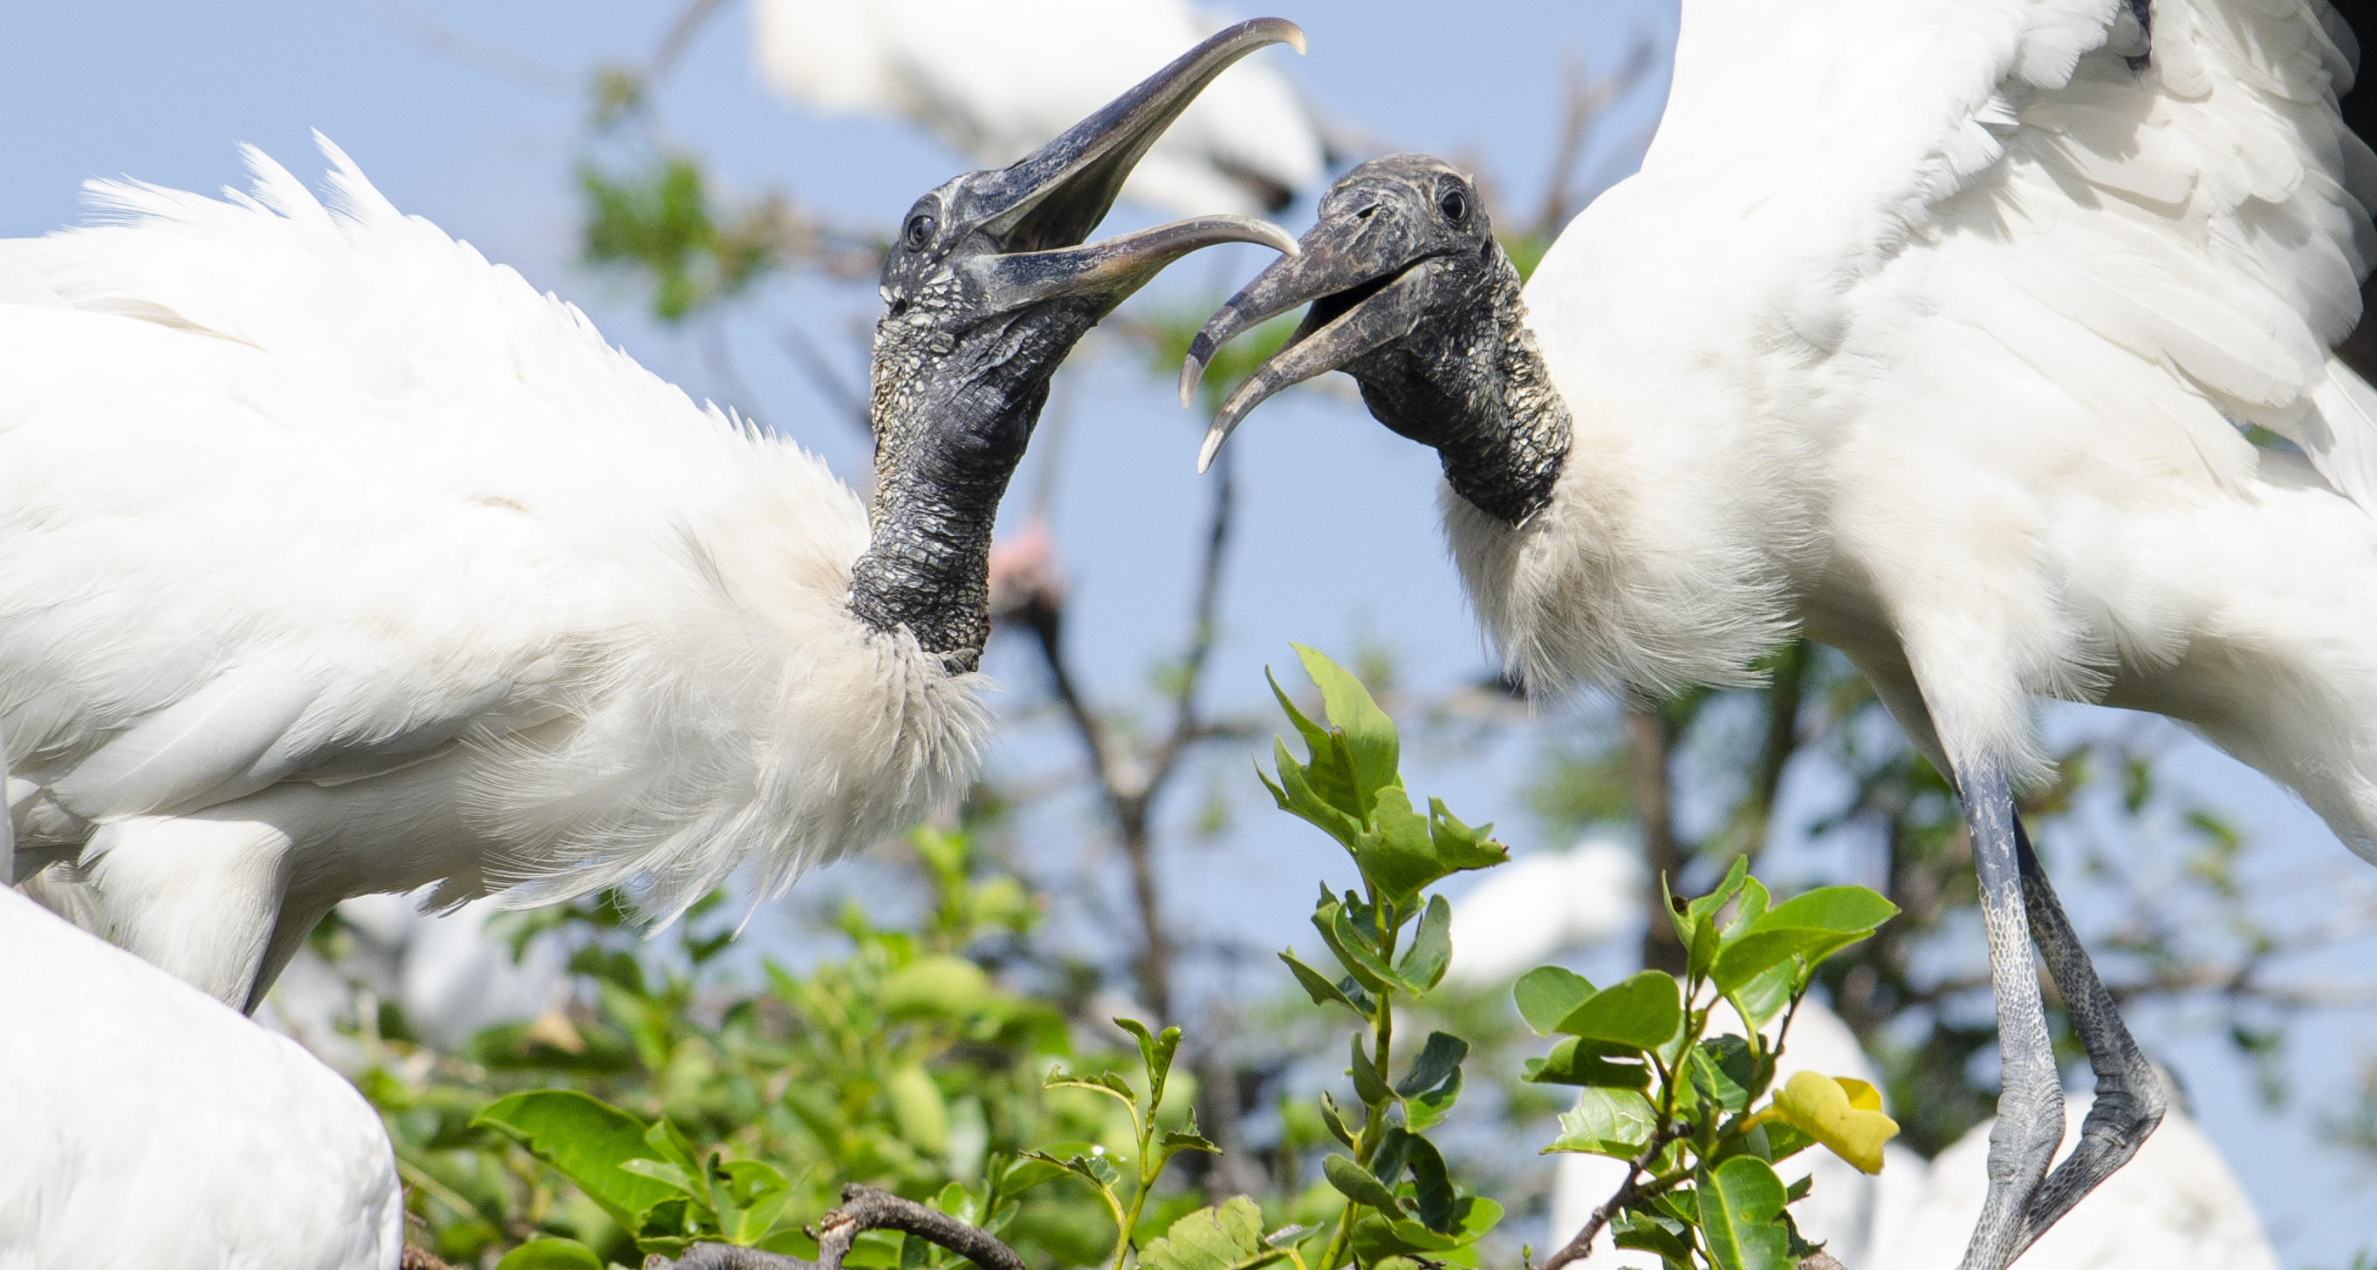
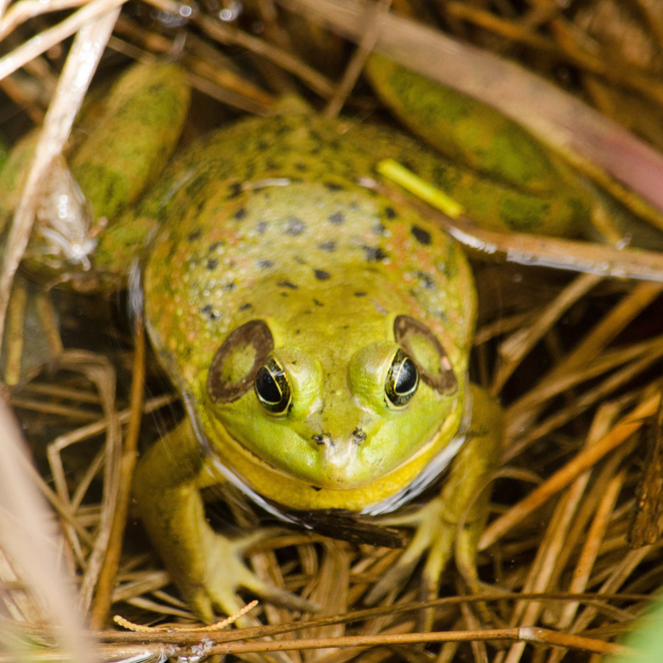
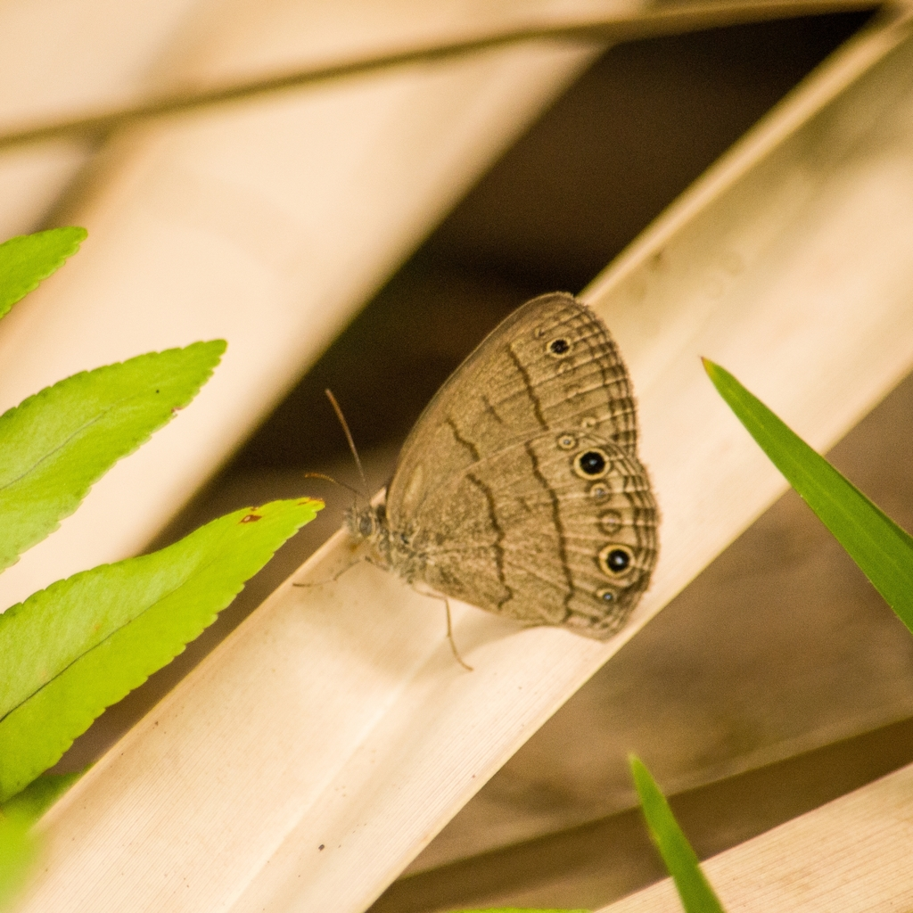
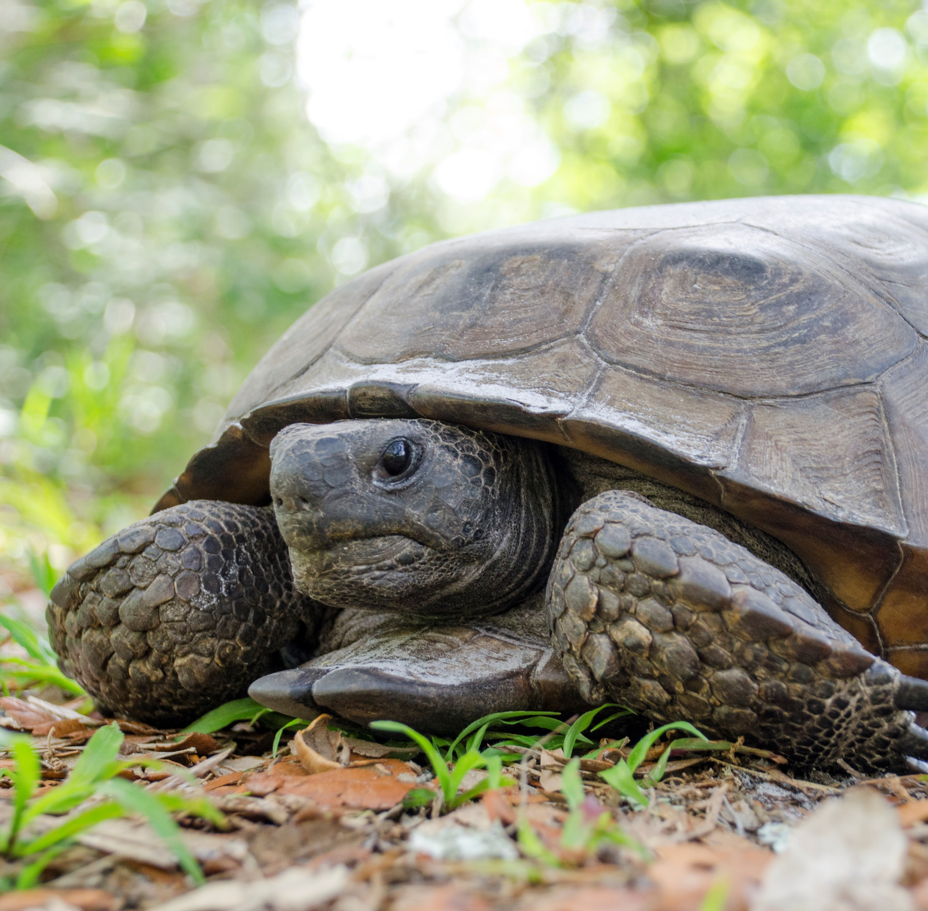
Thank you!
Brittany Mason
Data Management Analyst, UF
bmason1@ufl.edu

